Slide 1


Slide 2
Set Apart For His Glory - 1
The Book of Ephesians – An Overview
Chapters 1, 2, and 3
Andy Acreman, Thurrock Christian Fellowship
Sunday 8th March 2026
Notes:
The Holy Spirit spoke to me about doing a teaching series on the Paul’s Letter to the Church at Ephesus – specifically Chapters 4, 5, and 6. “His word is my command!”. So here it is!
The English word: “Holy” means: “Set Apart” or “Reserved” – especially for the work that God has for our lives. It’s a bit like the best set of china in the dining room – to be used only for really important occasions with really important guests!
2 Timothy 2:20-21 NIV. In a large house there are articles not only of gold and silver, but also of wood and clay; some are for special purposes and some for common use. Those who cleanse themselves from the latter will be instruments for special purposes, made holy, useful to the Master and prepared to do any good work.
Leviticus 11:45 NIV. I am the LORD, who brought you up out of Egypt to be your God; therefore be holy, because I am holy.
As Christians, we have been “Set Apart” for God’s glory; therefore, we need to live lives that are consistent with this new ‘status’. This Book of Ephesians tells us that we are “Set Apart” and shows us how to live in the way that pleases God. It is one of the best books in the Bible to teach us about practical holiness.

Slide 3
Set Apart For His Glory: Book of Ephesians Overview Today’s “Menu”
An Introduction: ‘Why are we doing this series?’
BibleProject ‘Video Sketch’ Summary of the Book of Ephesians
“A Game of Two Halves” (“A Book of Two Halves”)
Key Points from the First Three Chapters (brief)
Intro. to Chapters 4, 5, & 6: “Find Out What Pleases The Lord”
Tuning Up the Formula 1 Racing Car!!!

Slide 4
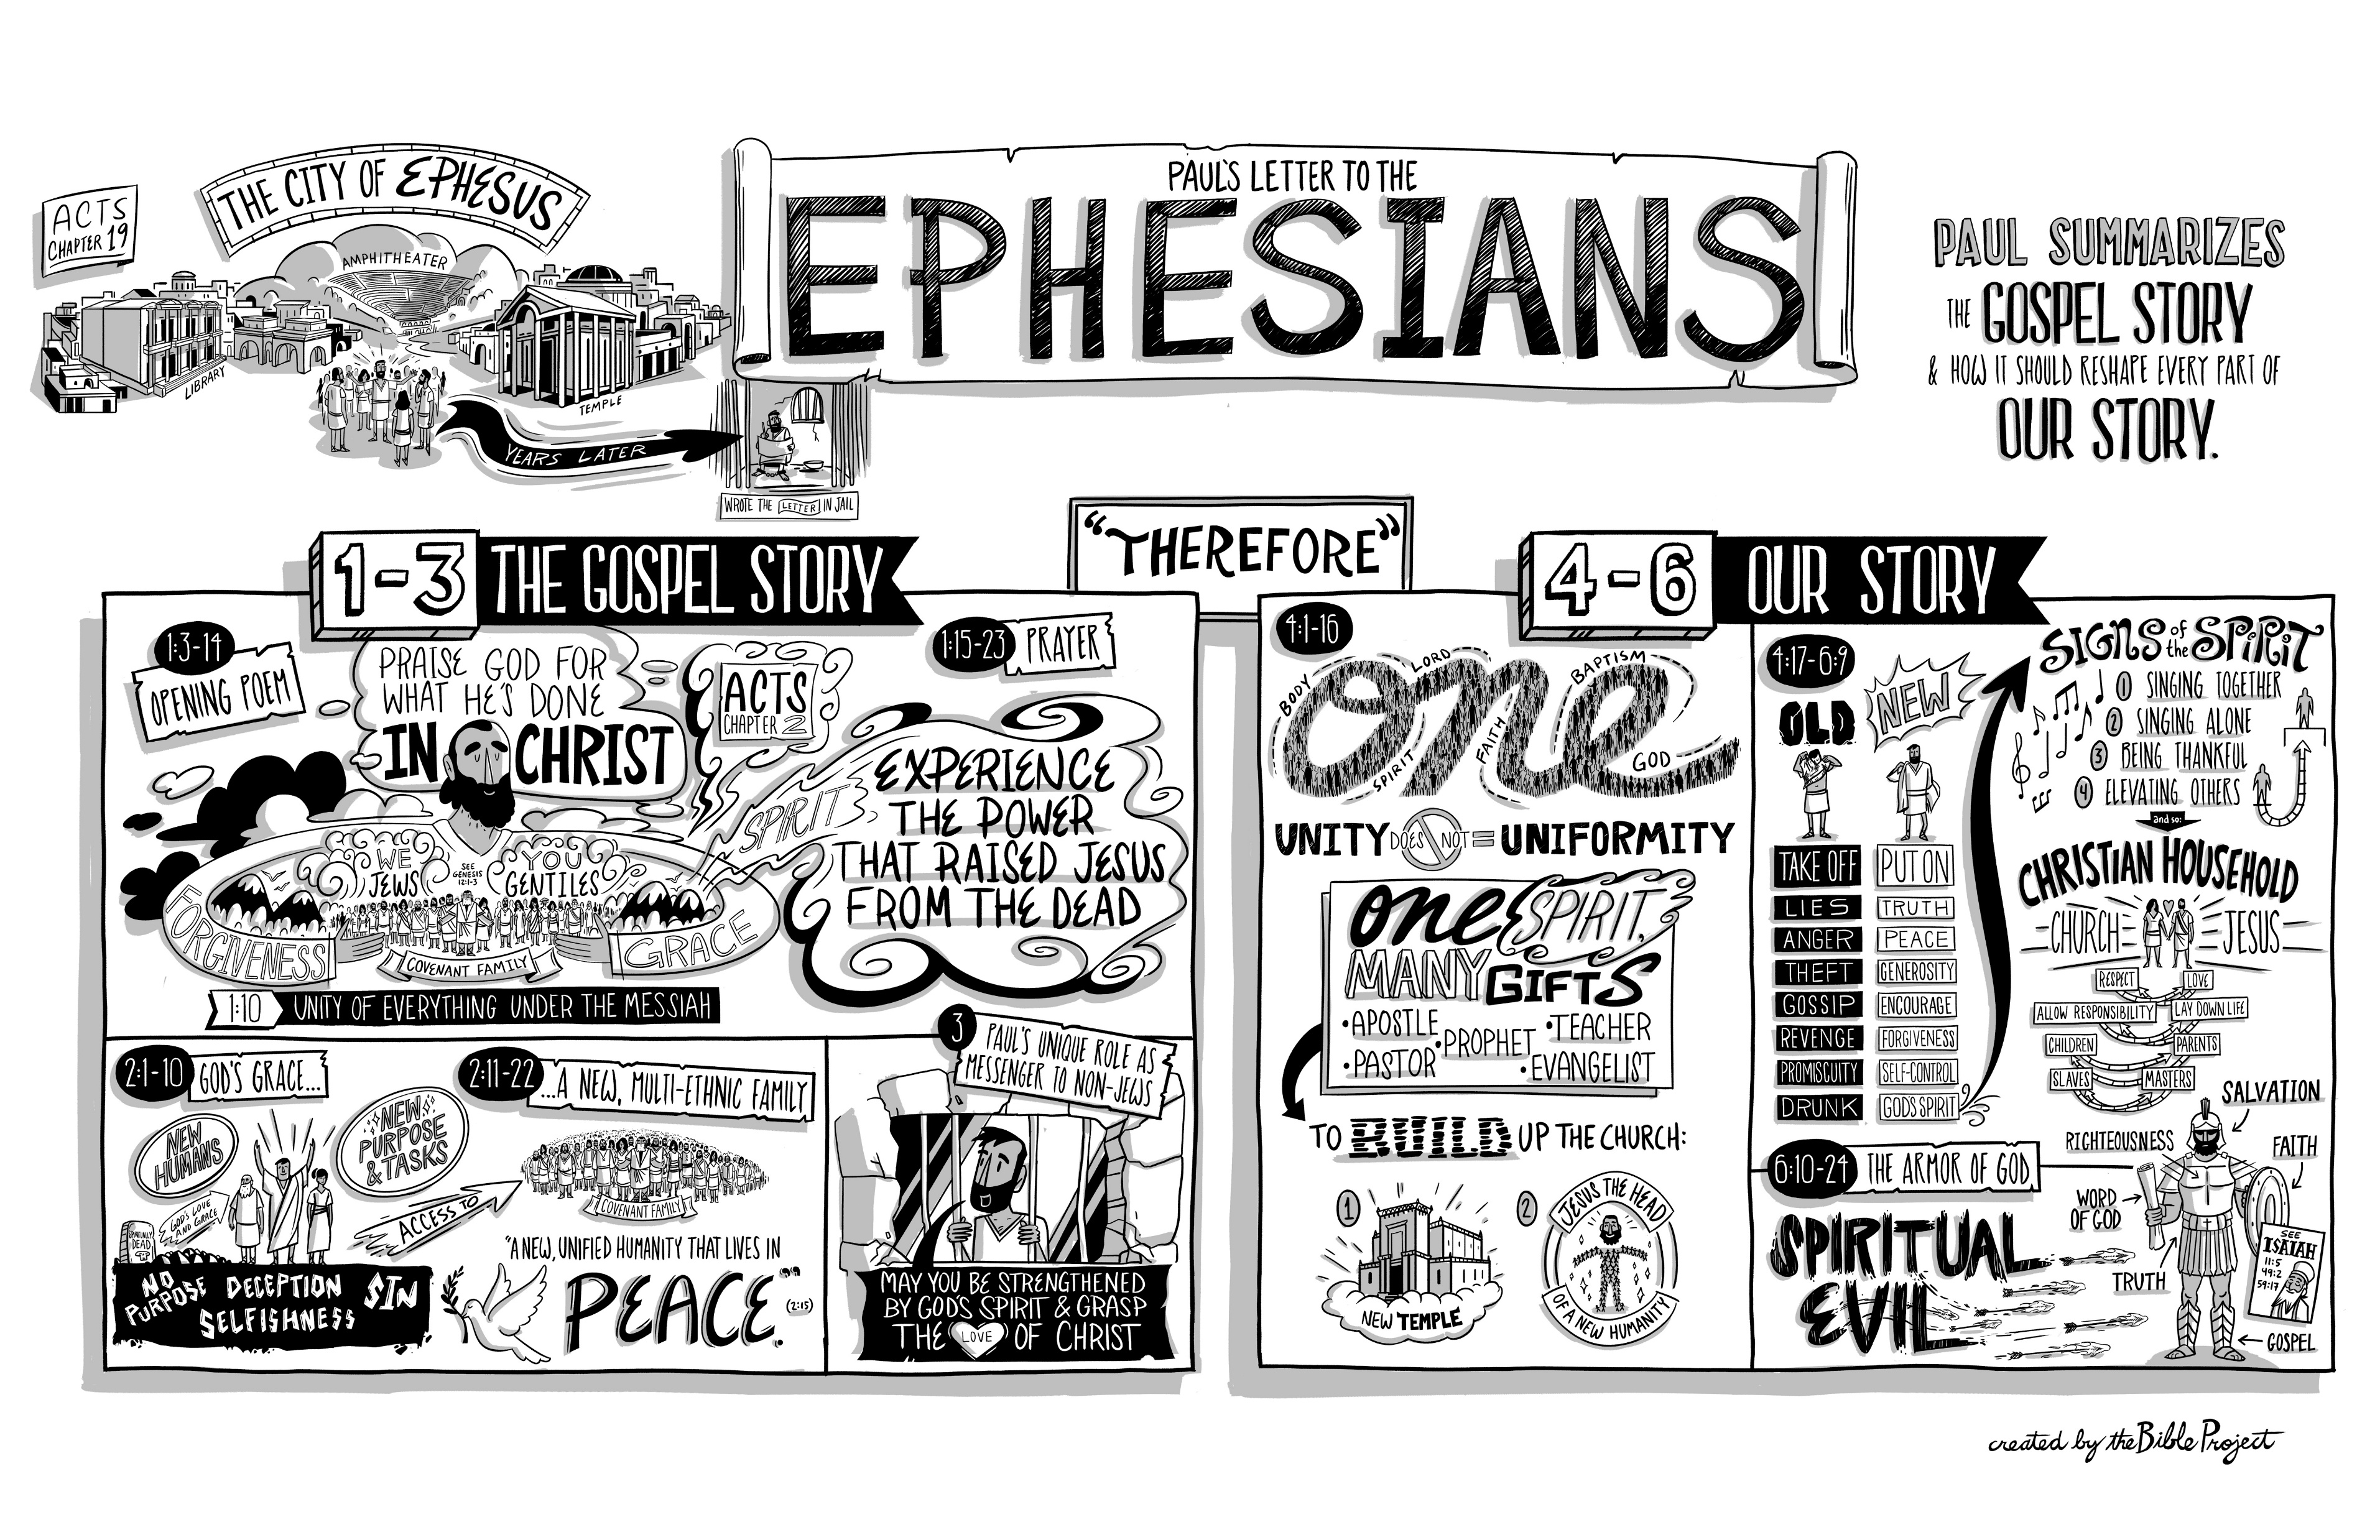
Set Apart For His Glory: Book of Ephesians Overview BibleProject ‘Video Sketch’
https://1drv.ms/v/c/05415c4dcfc197a9/IQBl31r1W81gSrWUaTk7B7nTAUS8iiS6fr_Fsk8K7Ig_9bU . CLICK ON THIS LINK
Notes:
This letter from Paul, but inspired by the Holy Spirit, contains more spiritual protein than a two-pound steak; so don’t expect to digest it all at one sitting!
In Paul’s time the city of Ephesus was the principal city of Asia Minor (modern Turkey) and a vast commercial hub for the Roman empire. It was also the hive of Diana worship (or Artemis, in Greek mythology) and a powerhouse of pagan evangelism for the Roman world, extending its spiritual ‘tentacles’ even to the present day.
In this great letter, no heresies are addressed (unusually), and no greetings are sent to named individuals (supporting the ‘circular letter’ theory).
The first half (chapters 1 – 3) contains pure undiluted doctrine, to give us a heavenly viewpoint – and to show us the immensity of God’s grace and His eternal purposes for his church, and for each one of us.
In this first half of the letter, there are virtually no commands to obey – it is as though God were saying to us: “Just sit, listen and think about all this”. The focus of the entire letter is: “The Church – Christ’s Body”; and we are to ponder the amazing grace that Christ has poured out on us as we take our place in the greatest organism ever created.
Let’s listen to BibleProject’s excellent visual summary of the Letter to the Ephesians…

Slide 5
Set Apart For His Glory: Book of Ephesians Overview “Ephesians: A Game of Two Halves”
TRUTH…. leads to…. HOLY LIVING
Notes:
Where does the expression: “A game of two halves” come from? A Football expression, meaning that the first half is very different from the second half of the match.
Similarly, the second half of the letter (chapters 4 – 6) is very different from the first half. It is a very practical outworking of the deep truth found in the first three chapters.
A Holy Life should always emerge from the truth, and only the truth will produce Holy Living.
In fact, you cannot live 4-6 without grasping 1-3; and if you don’t live 4-6, you haven’t grasped 1-3. A genuine faith always produces a good life. In fact, the Bible is God’s ‘Faith-Book’!
So, it should affect our unity of living, our maturity of mind, a renewed personal life and some re-born relationships. Marriage, family, employment will be unrecognizable from the world’s sad versions of these vital bricks of society.
We will realize that every moment of our re-born lives are now battles at the fiercely fought frontline between good and evil, heaven and hell. We only win such battles as we rely on air superiority and the victory of our Commander-in-Chief that has occurred already. Careless talk costs lives, so watch what you say!

Slide 6
Set Apart For His Glory: Book of Ephesians Overview Ephesians Chapter 1 – Key Points
FROM: Paul, an apostle of Christ, chosen by God
TO: God’s Holy People in Ephesus + all faithful believers in Jesus
PRAISE: For every blessing we have IN CHRIST…
Chosen individually before the world was created!
Each of us predestined to sonship - because of His love for us
Redeemed and forgiven by the blood of Jesus, the Messiah
Given wisdom and sealed with the Holy Spirit as our guarantee!
The Church is the physical body of Jesus on earth and in heaven
Notes:
KEY VERSE: Ephesians 1:22-23 NIV. And God placed all things under [Jesus’] feet and appointed him to be head over everything for the church, which is his body, the fullness of him who fills everything in every way.
The letter is styled a bit like an email: FROM, TO, SUBJECT…
This letter is all about God the Father searching for a heavenly Bride for His Son, Jesus. That’s the whole church, past, present, and future! Then the Holy Spirit prepares the Bride, purifying her, to be ready to meet the Heavenly Bridegroom when He returns for her.
Number One Truth: We are Christians because God CHOSE us – not the other way around. He has done everything to save us. We contributed nothing!

Slide 7
Set Apart For His Glory: Book of Ephesians Overview Ephesians Chapter 2 – Key Points
We were originally dead in our sins, choosing to follow Satan.
We lived selfish, sinful lives, and fully deserved God’s judgment
THEN: By His love, mercy and grace, God made us alive with Christ
God raised us up with Christ and seated us in heaven with Him
We are God’s masterpiece, created to do good - in His footsteps
We Gentiles are brought near and joined to Jewish believers
We are fellow-citizens, part of God’s ‘temple’, in heaven and earth
Notes:
This is our story: from spiritual death to spiritual life. Deserving only punishment, but receiving mercy and grace.

Slide 8
Set Apart For His Glory: Book of Ephesians Overview Ephesians Chapter 3 – Key Points
Paul’s role in this, and God’s plan for us all. To bring Him glory!
A ‘mystery’ is truth that has been hidden and now is revealed
Along with Israel*, we are heirs, members, and sharers of promise
Role of the Church is to model God’s wisdom to all ‘dark’ powers
We can now approach God with freedom and confidence
He is able to do so much more than all we can ask or imagine!
Notes:
* When Paul uses the term ‘Israel’, he means those Jewish people who have received Jesus as their long-awaited Messiah and Saviour – Jewish Christians!
We are a living demonstration of God’s grace, his glory, and his wisdom. Like a giant masterpiece of a painting that has just been uncovered by royalty!
As we ask for more things, and as we stretch our imaginations, we receive much more from the Lord.

Slide 9
Set Apart For His Glory: Book of Ephesians Overview Ephesians Chapters 4 – 6: Topics to Cover
UNITY is the ‘Prime Directive’ (4:1-16) John
Living as ‘SET APART’ ones (‘Holy’) (4:17-24) Phil
Putting OFF and Putting ON (4:25-32) Sunny
Living as ‘Children of Light’ (5:1-14) David
Getting Drunk on the Holy Spirit (5:15-21) Gillian
Submission in Christian Marriage (5:22-33) Judith
Submission in Home and Workplace (6:1-9) Oyin
Putting On the Armour of God (6:10-20) Andy
Notes:
This is how the Bride – the Church – is being prepared to meet her Heavenly Bridegroom, Jesus, when He returns.
Each week is a different set of lessons for us to learn AND to put into practice! Why? Because it pleases Him.

Slide 10
Set Apart For His Glory: Book of Ephesians Overview Final Thoughts…
“Find out what pleases the Lord” (Ephesians 5:10). Not Law.
Four reasons to please God, to live ‘Set Apart’ lives:
Gratitude for His love and kindness towards us
Glory goes to God Himself (“Set Apart for His Glory!”)
We can Gaze upon his majesty, beauty and power!
A ‘finely tuned’ F1 racing car has power to travel at high speeds
As we live ‘Set Apart’ lives, we move effortlessly in the power of God!
Notes:
Let’s make this our life’s work: finding out what pleases the Lord… and doing it!
Hebrews 12:14 NIV. Make very effort to live in peace with everyone and to be holy; without holiness no one will see the Lord
Ephesians 3:20-21 NIV. Now to him who is able to do immeasurably more than all we ask or imagine, according to his power that is at work within us, to him be glory in the church and in Christ Jesus throughout all generations, for ever and ever! Amen.

